Slide 1
Online Quiz Assessment System
NAME:AKSHAYA
REG NO:43733010
DEPT:BE CSE DS

Slide 2
INTRODUCTION
The project aims to automate the process of Online Quiz Assessment System.
It provides a platform to conduct quizzes online for students.
It reduces manual effort and saves time.
It provides instant result and performance analysis.
Online Quiz Assessment System consists of Admin Module and Student Module.

Slide 3
ABSTRACT
Online Quiz Assessment System (OQAS) is a web-based application.
The main objective is to manage quizzes and assessments online.
It allows students to attend quizzes and view results instantly.
Admins can manage quizzes, questions, and students.
This project is developed using Spring Boot and MySQL.

Slide 4
What we are going to build: Client Requirement
Client wants an Online Quiz Assessment System.
Admin can manage quizzes, questions, and users.
Students can attend quizzes online.
System should evaluate answers automatically.
Results should be displayed immediately.

Slide 5
What we are going to build: Some technical terms
Proper Login and Registration.
Role-based authentication.
Proper input validation.
Exception handling.
REST API based architecture.

Slide 6
What are the technologies and tools we are going to use?
Framework: Spring Boot.
Language: Java 17.
Build Tool: Maven.
IDE: Spring Tool Suite (STS).
Database: MySQL.
Testing Tool: Postman.

Slide 7
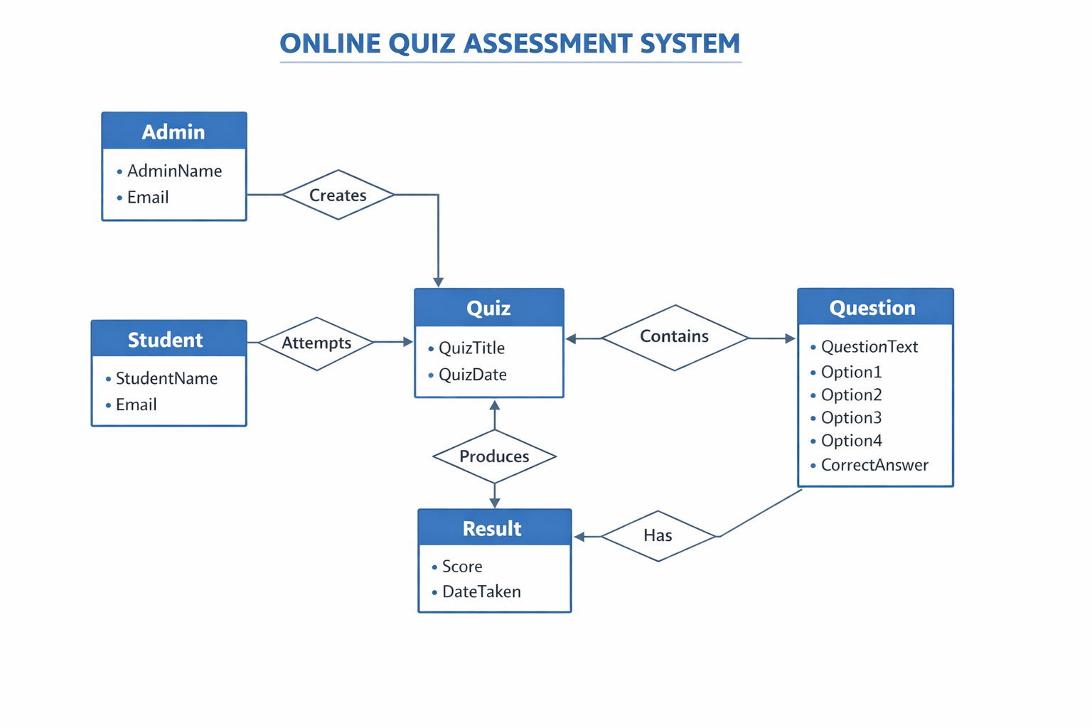

Slide 8
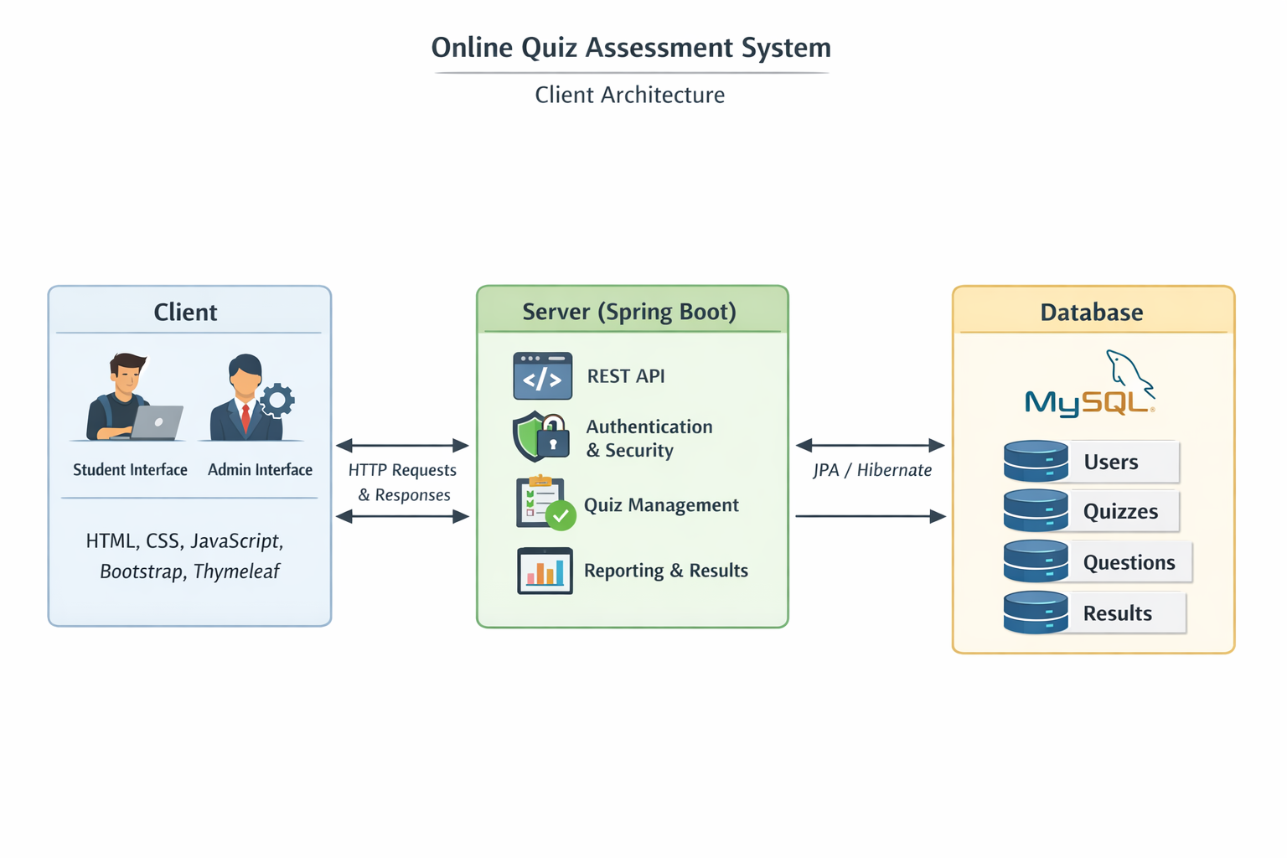

Slide 9
SYSTEM REQUIREMENTS
Backend: Spring Boot, JPA Hibernate.
Database Server: MySQL 8.0.
Web Server: Apache Tomcat.
IDE: Spring Tool Suite.
Browser: Google Chrome.

Slide 10
PROJECT MODULE
Admin Module.
Student Module.
Quiz Module.
Question Module.
Result Module.

Slide 11
ADMIN MODULE
Admin can login securely.
Admin can create, update, and delete quizzes.
Admin can manage questions.
Admin can view student results.

Slide 12
STUDENT MODULE
Student registration and login.
View available quizzes.
Attend quiz within given time.
View result instantly.

Slide 13
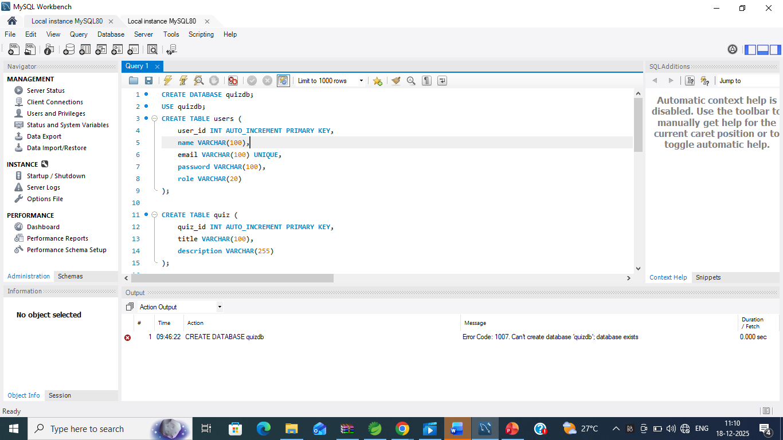

Slide 14
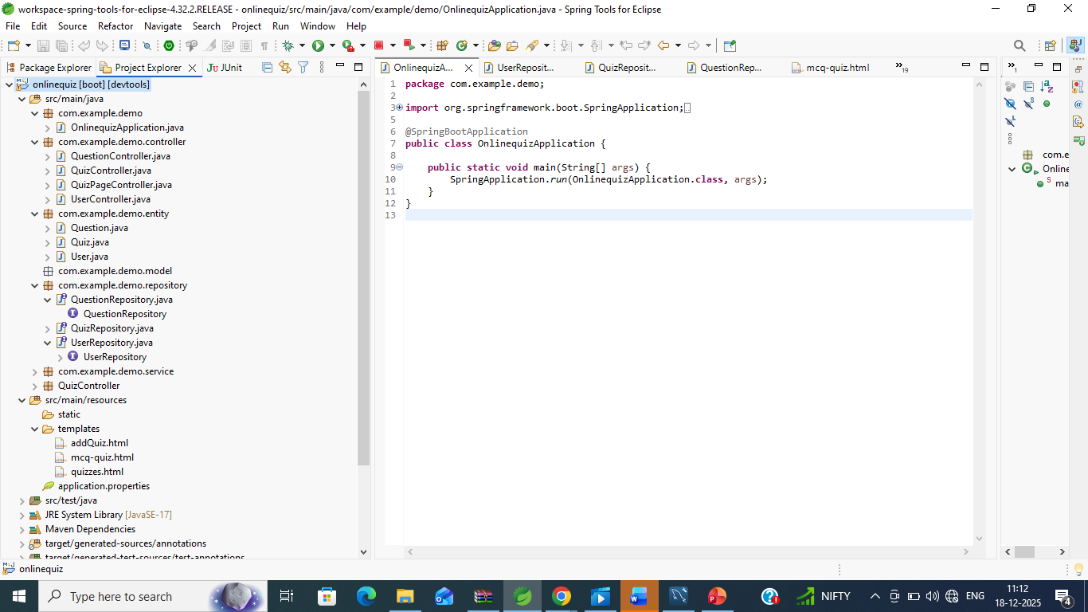

Slide 15
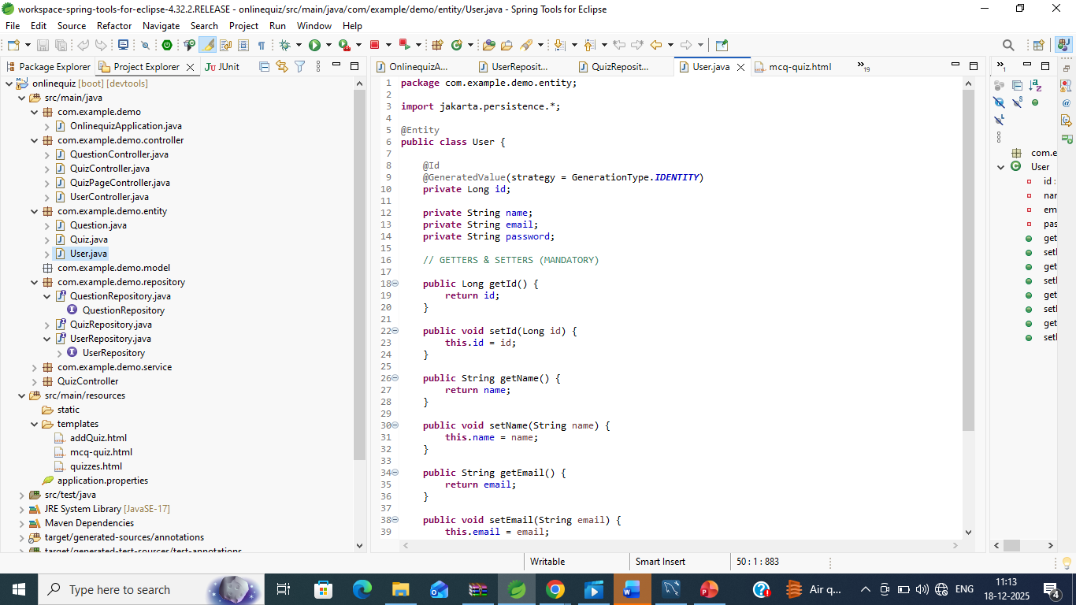

Slide 16


Slide 17
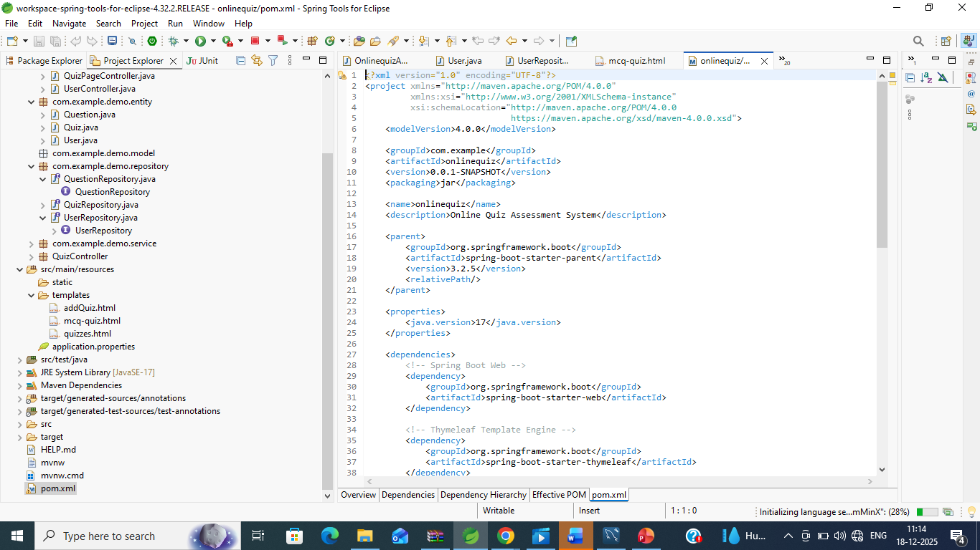

Slide 18
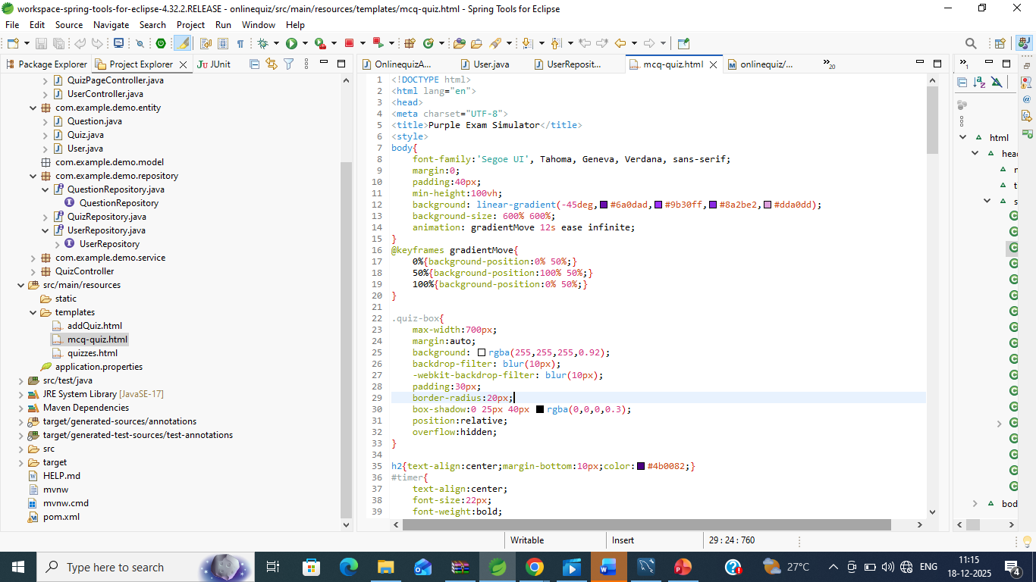

Slide 19
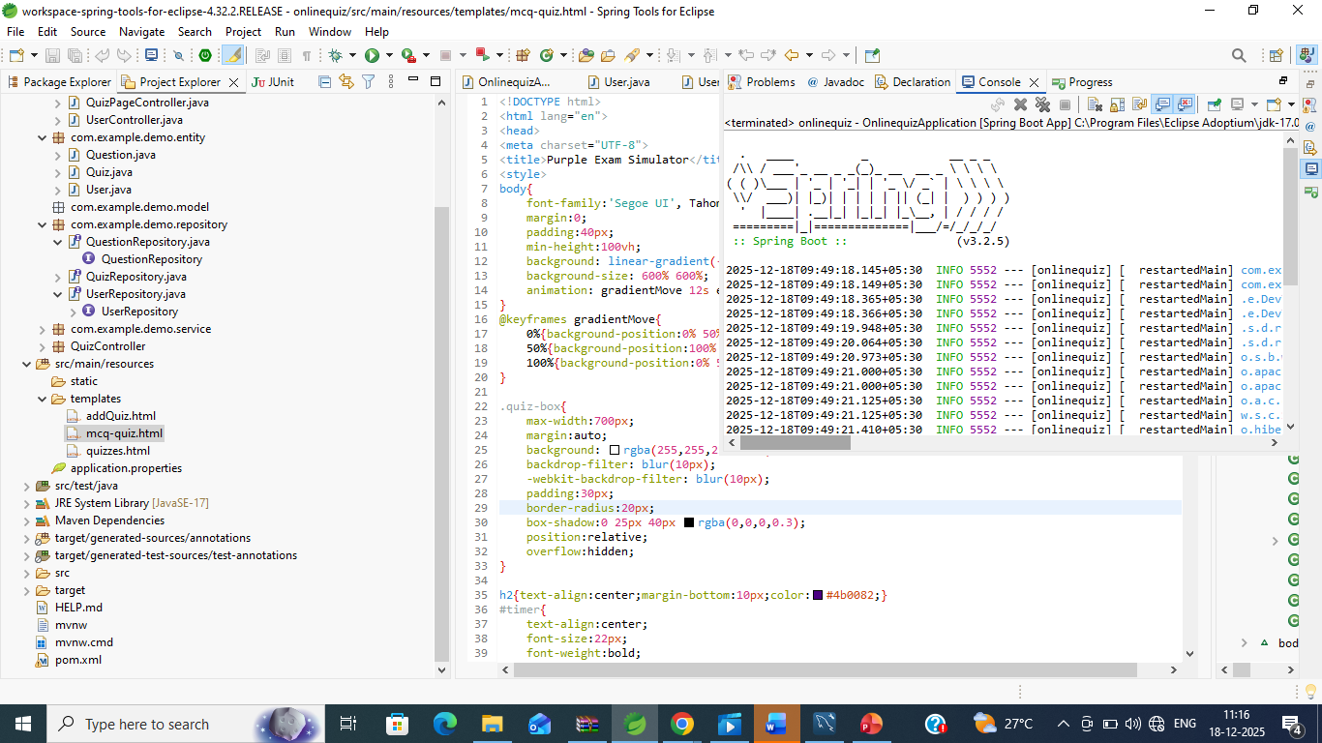

Slide 20
HTTP REQUEST METHODS
GET – Retrieve data.
POST – Insert data.
PUT – Update data.
DELETE – Delete data.

Slide 21
CONCLUSION
Online Quiz Assessment System simplifies examinations.
It provides fast and accurate evaluation.
It is user-friendly and reliable.
Useful for educational institutions.

